Slide 1
التقانات الحياتية النباتية
أ.د. عقيل هادي عبد الواحد
كلية الزراعة
جامعه البصرة

Slide 2
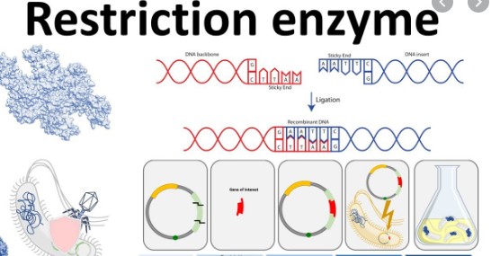

Slide 3
Character | Type I | Type II | Type III
Nature of the enzyme | single multifunctional enzyme | Endonuclease and methylase | single multifunctional enzyme
Molecular weight | 450kDa | 20-30kDa | 200kDa
Protein conformation | 3 different subunits | 2 proteins | 2 different subunits
Cofactors | Ado-met, ATP, Mg2+ | Mg2+ | Ado-met, Mg2+, ATP
Cleavage site | 1000bp from recognition site | Within recognition site | 24-26bp to 3' recognition site
Site of methylation | Recognition site | Recognition site | Recognition site

Slide 4
Derivation of the EcoRI name
Abbreviation | Meaning | Description
E | Escherichia | genus
co | coli | species
R | RY13 | strain
I | First identified | order of identification in the bacterium

Slide 5
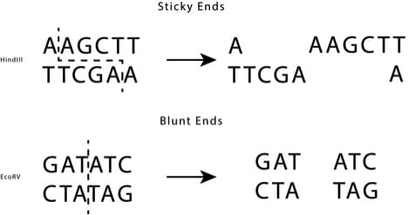

Slide 6
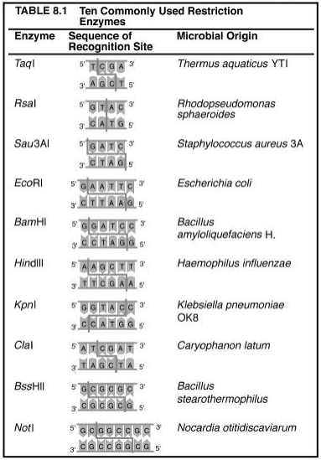

Slide 7
شكراً لحسن اصغائكم

